Slide 1

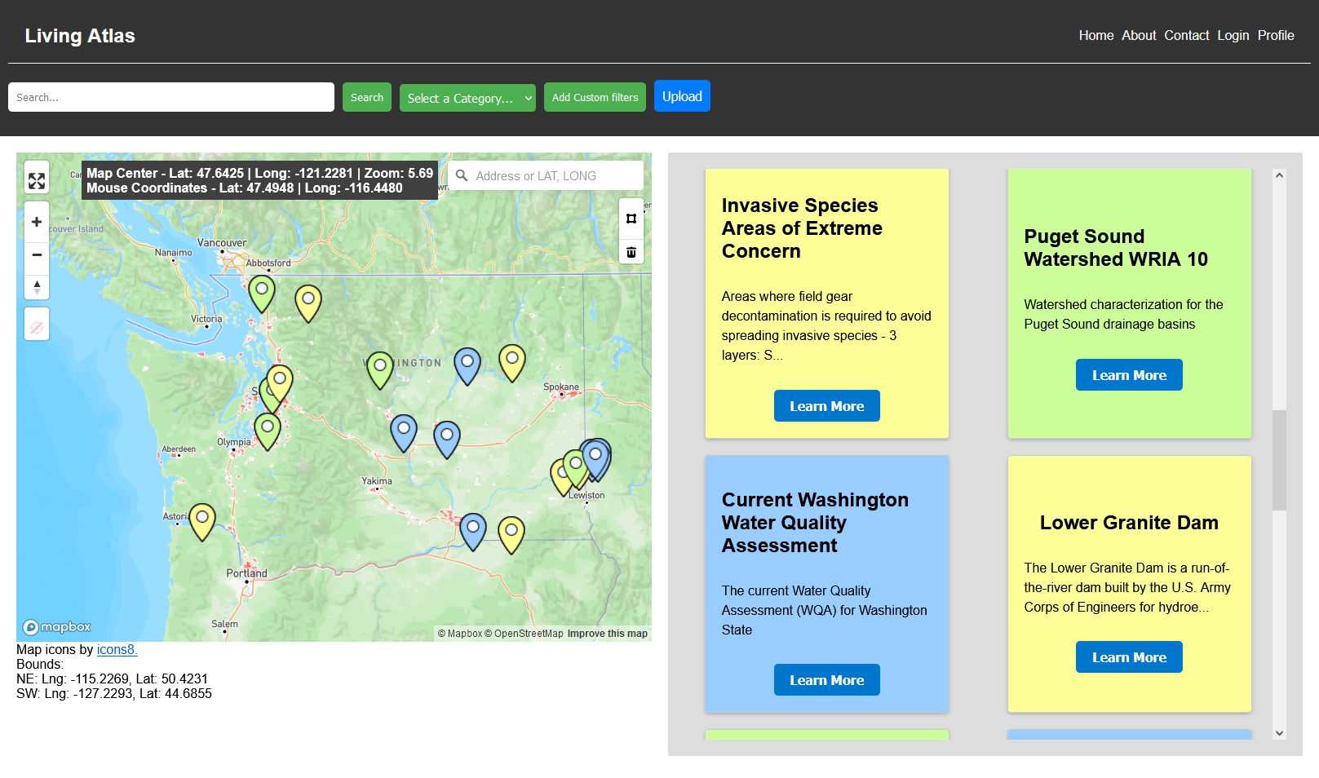
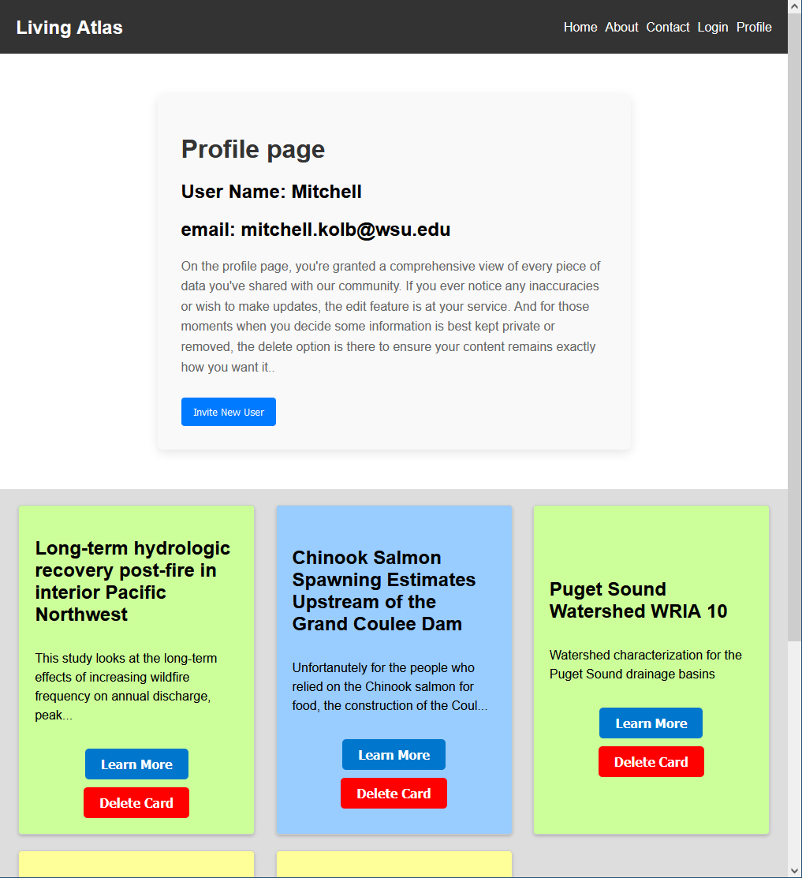
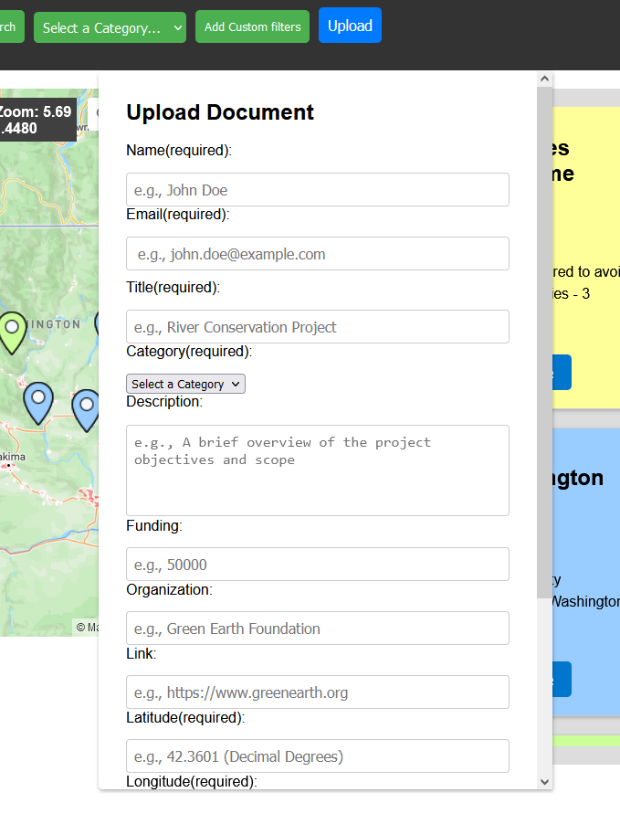



Living Atlas Platform Sponsor: CEREO Mentor: Balasubramanian ‘Subu’ Kandaswamy Team: Joshua Long, Sierra Svetlik, Mitchell Kolb
Abstract
Everybody knows that we are facing environmental challenges
There is a lot of research out there to help us solve this challenge
We need a central hub for environmental research
A visual and interactive interface where we can upload, download, and view the research
All data uploaded is linked with longitude and latitude, which can be displayed on the live map
Full-stack web application comprising three key layers: Frontend, Backend, and Database
Solution
A web application featuring a map to the left and cards to the right representing points on the map that can be filtered.
The app was developed in 3 parts: React for the frontend (the UI), FastAPI for the backend (which connects the front to the database), and ElephantSQL for the database (which stores all the information for the app)
Features/Functionality
While anyone can access the map, cards, and all the filtering options only registered users can upload information to the website.
When a new card is uploaded, information such as the longitude and latitude is entered, along with a category for the data, and tags to help filter the cards for users looking for specific information.
Registered users can also invite new users from their profile page. This will help keep the app restricted to trusted users.
Final Status
Completed core set of features
Deployed all 3 sections of the website (frontend, backend, database)
Approved by clients
Future Work
Admin account moderation tools
Ability to upload only files
Backend deployment service which has a 100% uptime
More efficient/effective CI/CD
Scalability
Implementing a custom domain
Glossary
CEREO: Our Client is the Center for Environmental Research, Education, and Outreach
Acknowledgements
Dr. Jan Boll, Dr. Julie Padowski, Dr. Hannah Haemmerli, and Mentor Professor Subu
Living Atlas 1

